Slide 1

PlayerUnknown's Battlegrounds
Dataset
By: Jiancong Zhang, Ulyses Pena, Shawn Tran, Kevin Wang, and Cody Wong
CIS 4560-01 Introduction to Big Data
4/17/2021

Slide 2
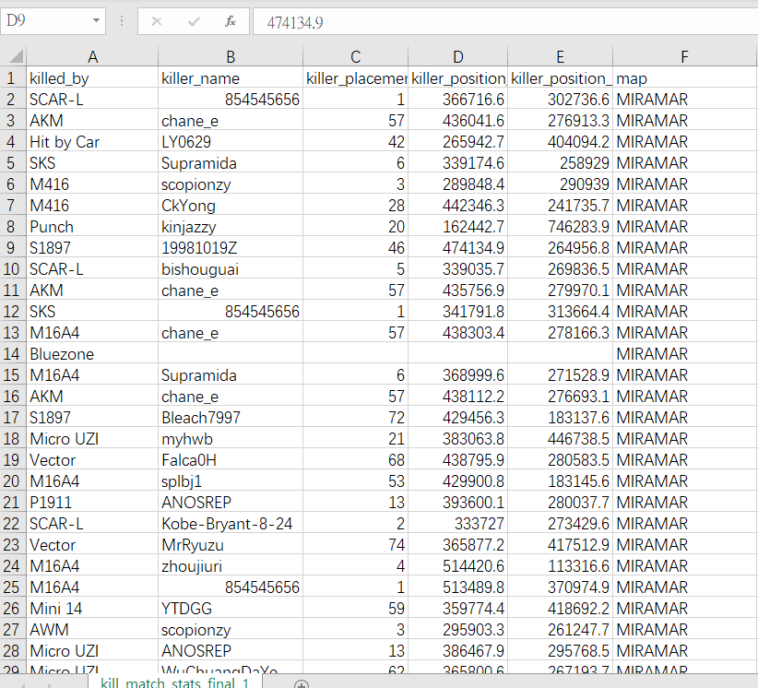
Summary of our Dataset
• Data size is approximately 1.87 GB
• Dataset contains 12 columns.
• Dataset contains two zips which are aggregate and deaths.
• Aggregate data provides statistics on player kills, damage, distance walked, and other metadata.
• Deaths provides for an event for every row that details the location of where the player died in the match.

Slide 3
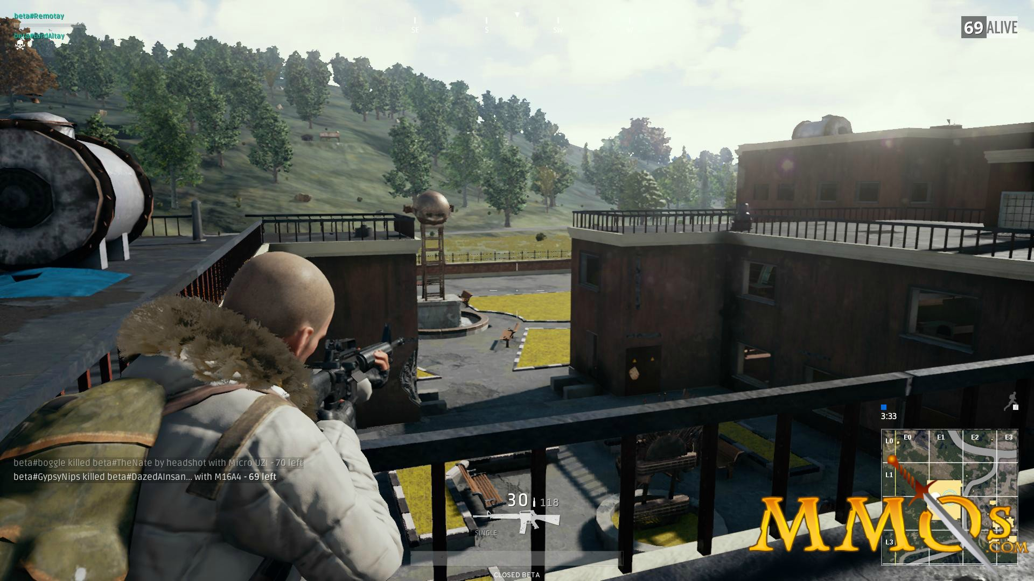
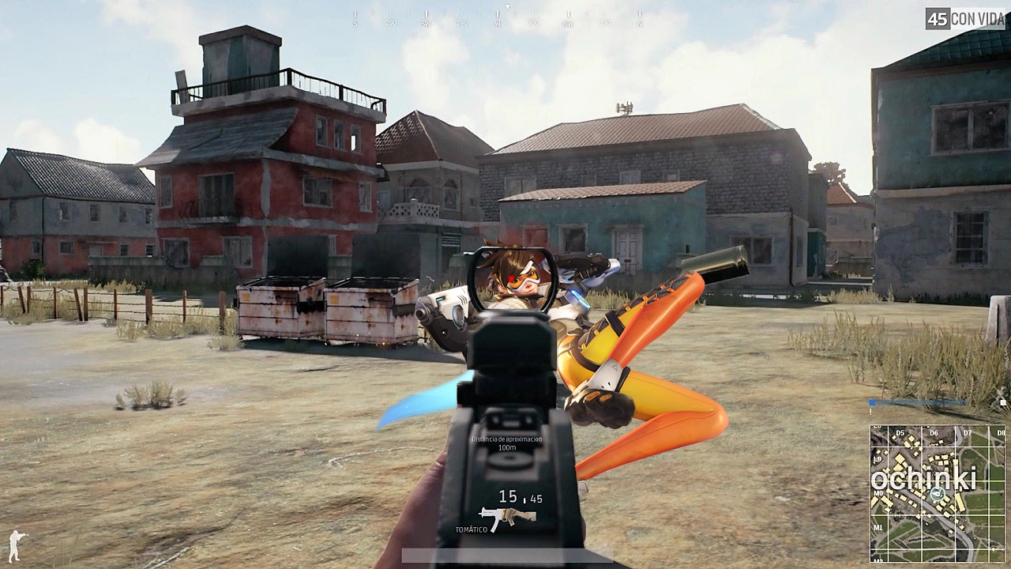
PUBG
PUBG is a first/third person shooter battle-royale style game.
The game is simple to learn but hard to master.
The game revolves around players fighting to the death until last player remaining.
The last player remaining is the winner of the match.
Match consists of up to 100 players.
Players are dropped from an airplane to a specific area.
Area is very large so players can hide.
Players scavenge for resources.

Slide 4
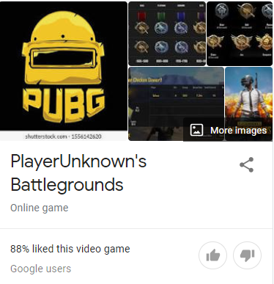
Goal of the Data Analyzing
Assist the product manager by providing the data insights but not limited to :
1. Balance the game system.
2.Improve players experiences
3.Increase the chance for players to survive and win the game.
4. Tips on areas to avoid that have high player death counts.

Slide 5

Experimental Specifications
H/W S/W spec of SCU Hadoop Server(KR):
3 Nodes Hadoop 3.1.4 Cluster: 3 x (16 Cores, 64GB, 8 TB/ 6TB (Raid))
Total: 48 Cores CPU, 192GB memory, 24TB/18TB (RAID)
PySpark: Python 2.7.5, Spark 2.3.2.3.1.4.0-315

Slide 6
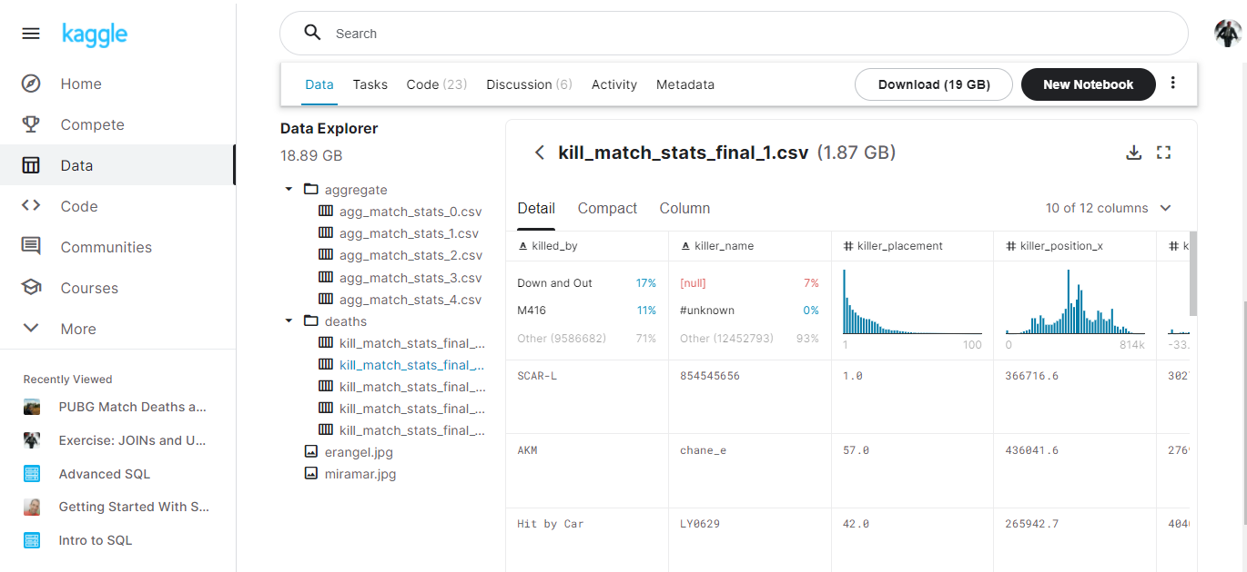
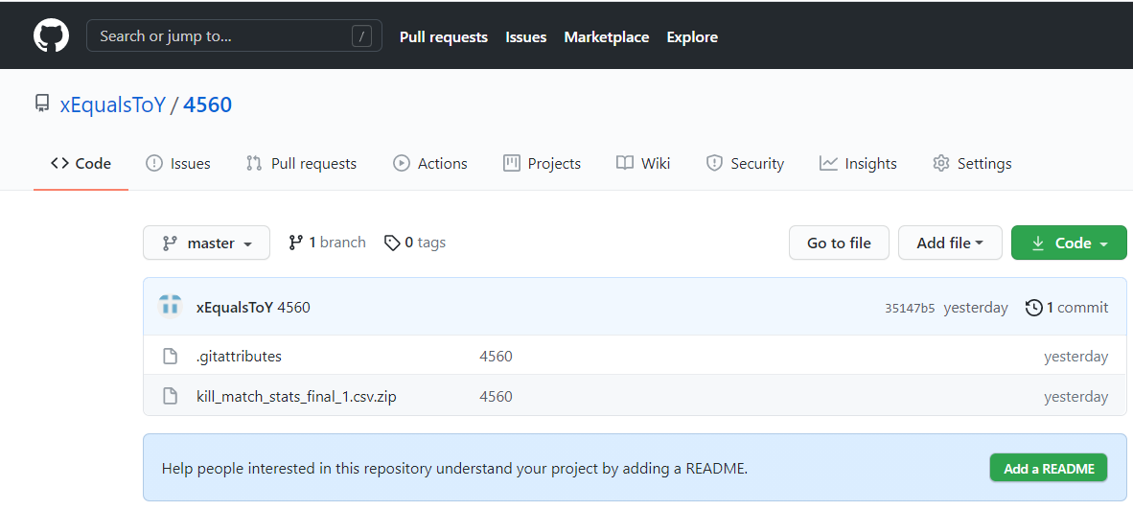
Where to find the Dataset
Our dataset can be found in Kaggle
Download Kill_match_stats_final_1.CSV
https://www.kaggle.com/skihikingkevin/pubg-match-deaths
Or you may download it from our github repository.
Link: https://github.com/xEqualsToY/4560

Slide 7
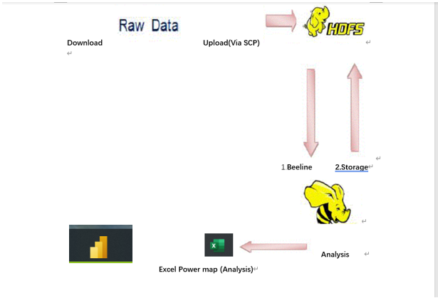
Workflow chart

Slide 8
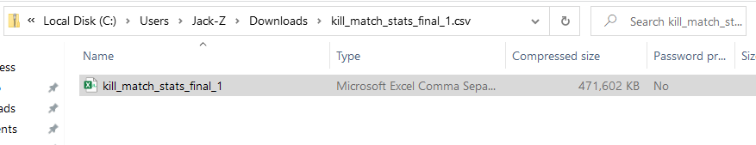
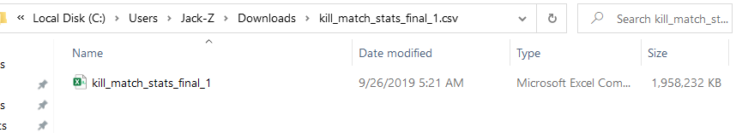
Step 1: Download Dataset
Download a compressed file from the kaggle link.
The name of the compressed file is called killer_match_stats_final_1.csv.
The compressed file size is 471 MB.
Once the download is finished you will then extract the file.
Compressed
Un-compressed

Slide 9

Step 2: Download WinSCP
Download WinSCP. https://winscp.net/eng/index.php
WinSCP is free and open source SSH file transfer.
When you open it make sure to pick as your session SCP.
Then for host name put the IP address of the server which can be oracle or korean server.
After that enter your username and password.
Drag the extracted file you extracted from Step 1 and wait for file transfer to finish.

Slide 10
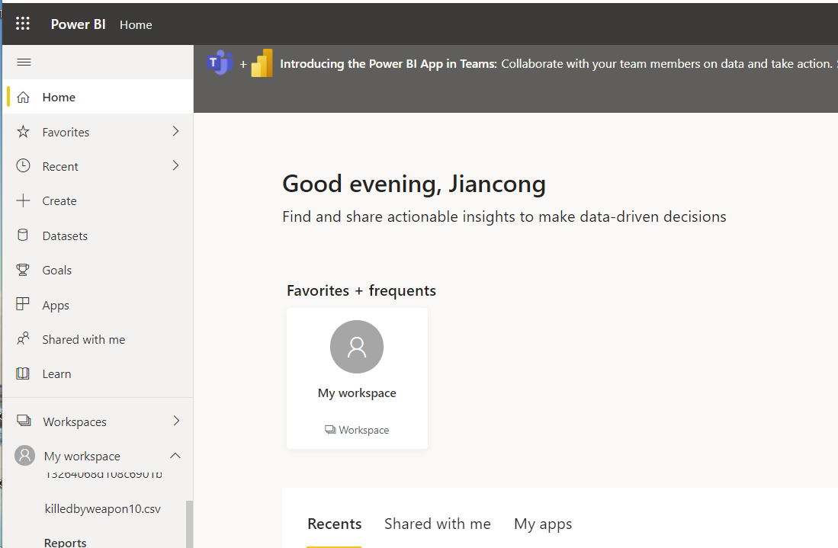
Bar Chart
Visualization will be done using Power BI bar chart.
This chart will display the weapon used.
The chart will also display the number of deaths by each weapon and which weapon kills the most amount of players.

Slide 11
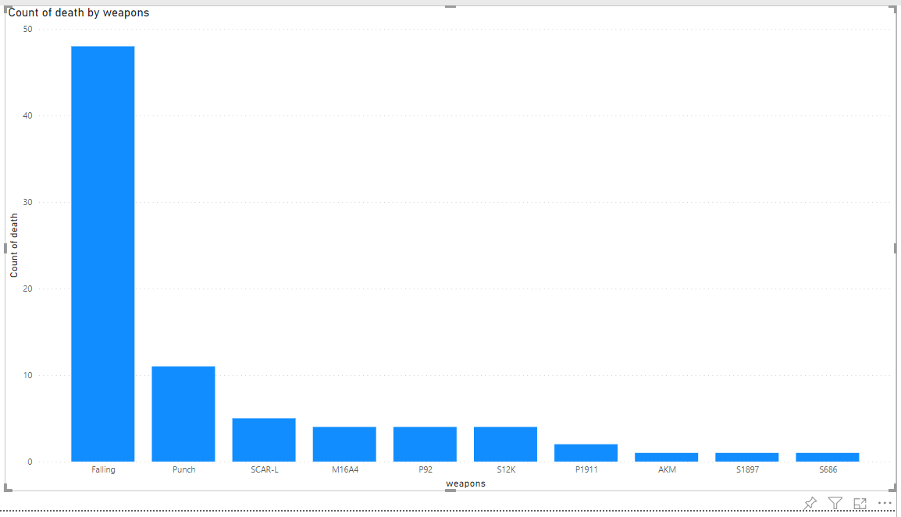
Death by Weapons happen in first1 min

Slide 12
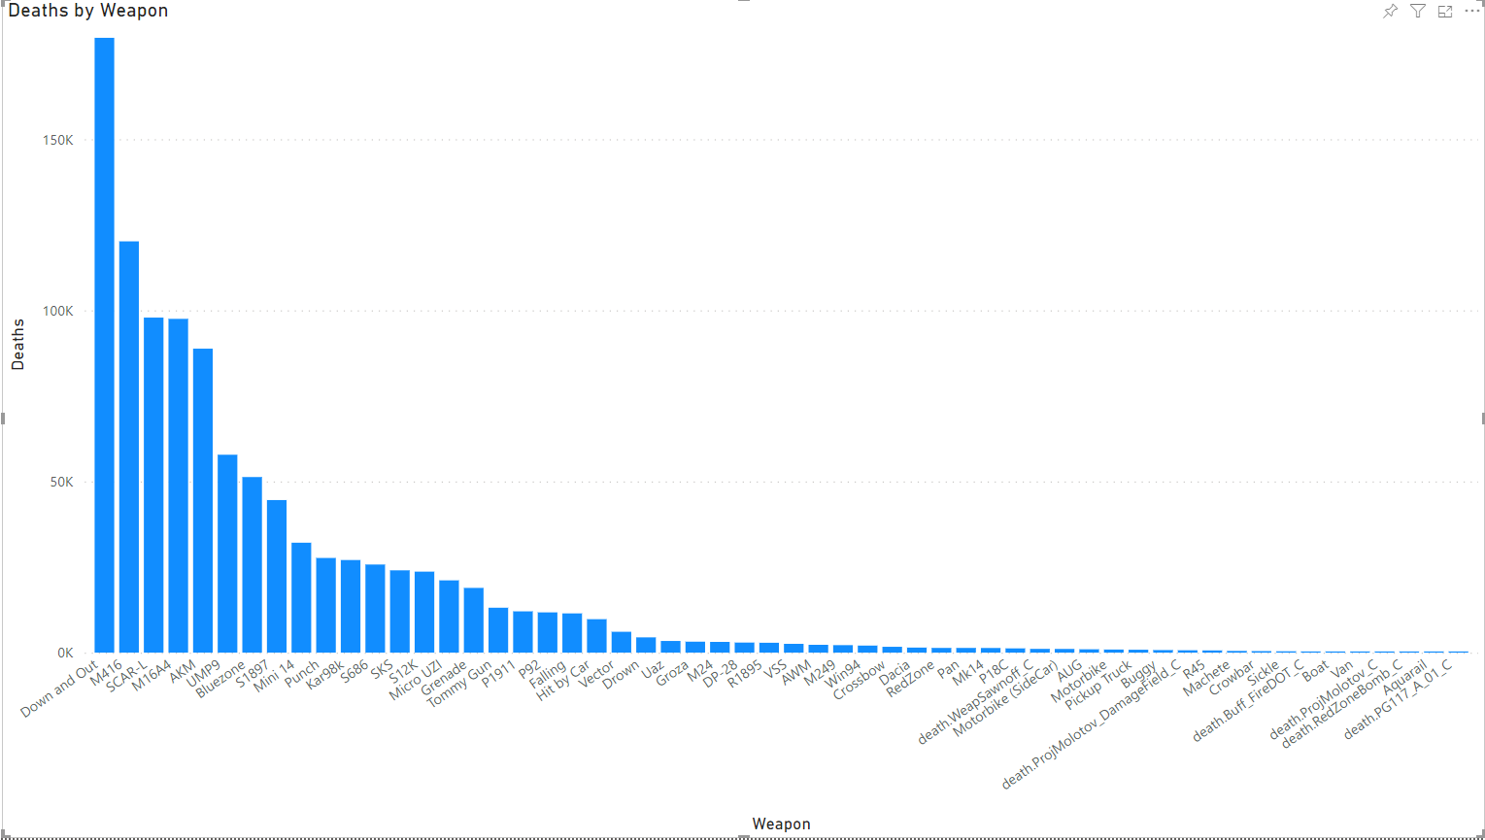
Death by Weapons final game

Slide 13
Geo Map Introduction
The geo maps will display heat signatures or red spots in different locations.
The red spots indicate dangerous areas and where players die a lot.
The map’s name shown in the next slide is called Erangel.

Slide 14
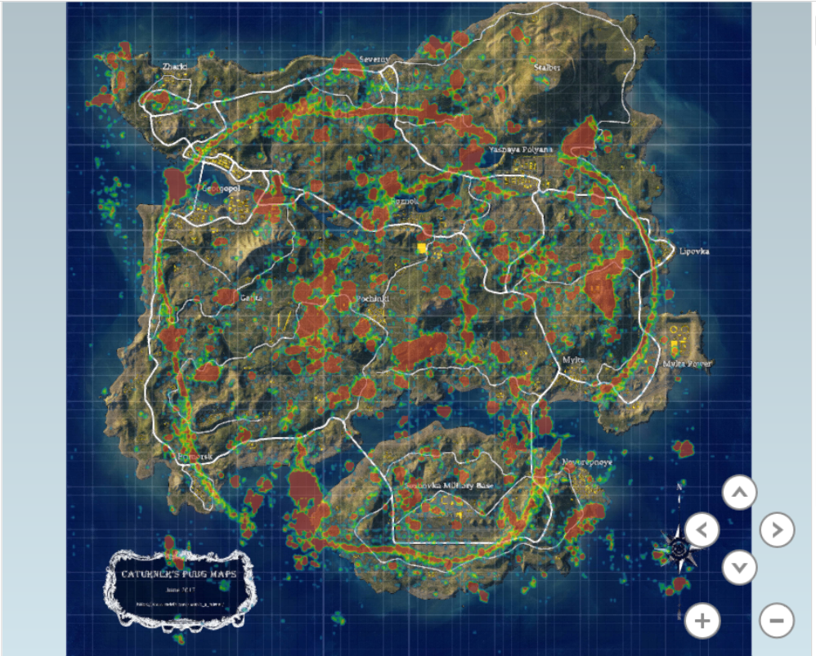
Geo-Map
Death Location
in 2 mins at game
Death hotspots are mainly located at points of interests at 2 minutes into the game as players are landing and looking for weapons.

Slide 15
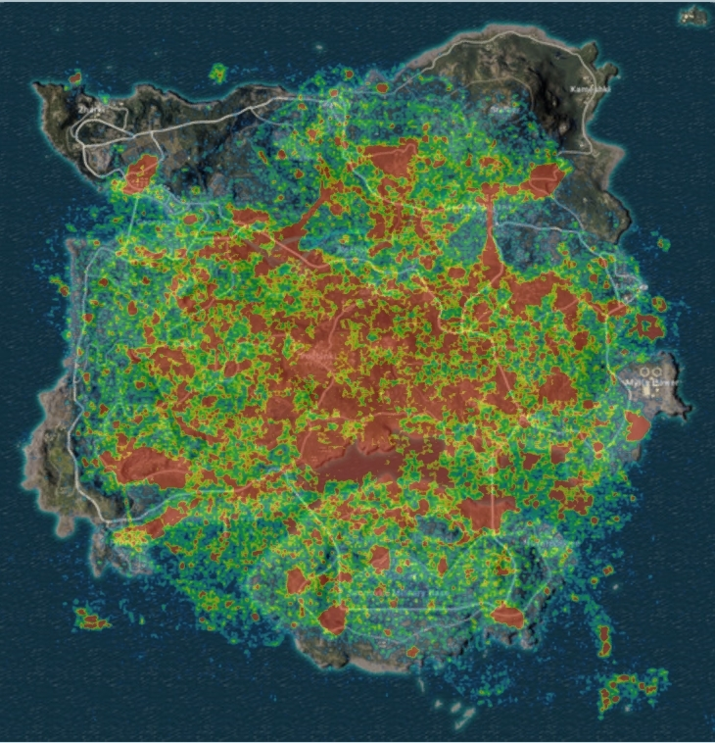
Geo-Map
Death Location
end at game
Central areas become highly dangerous as the game goes on, as players begin to move towards the center of the map.
Notes:
Locations in the map that are most dangerous for players are school, pochinki, farm. Also Mylta power is an area that is safe.

Slide 16

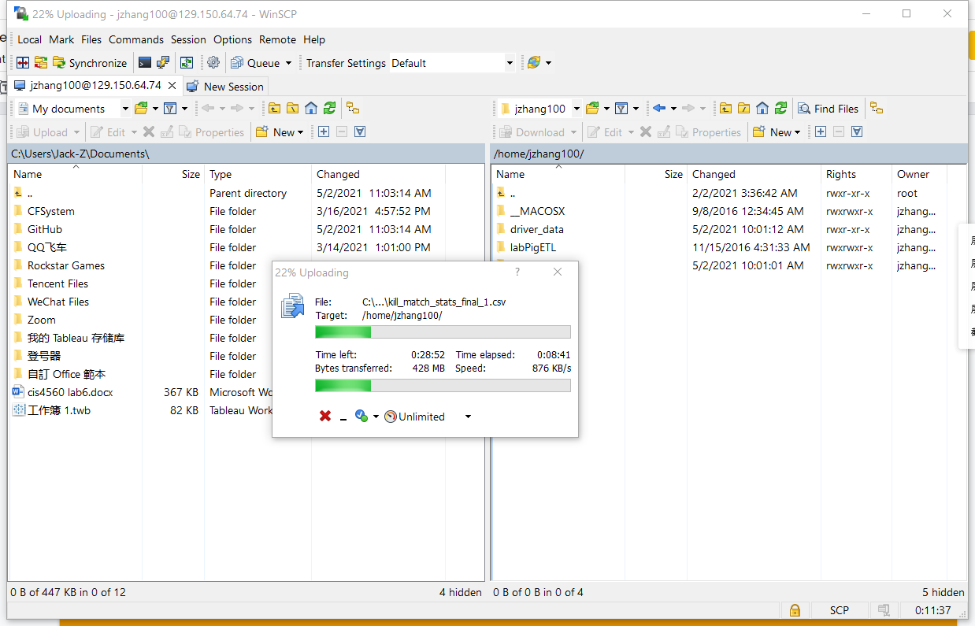
Login Into Server
After the loading bar gone through, there should be a file named kill_match_stats_final_1.csv
At the left side and consist about 18,700,000 kb/ 1.87G
Data analysis can significantly improve our ability to grasp the information hidden in the data

Slide 17

Group 4.
Thank you!
Q&A Time.

